Slide 1

MICROSOFT MOVIE STUDIO ANALYSIS
Sabina Bains
October 2021

Slide 2
OBJECTIVE AND METHODOLOGY
Explore historical movie data to determine types of movies that are most successful at the box office for Microsoft’s studio to utilize
Data sourced from The Numbers (https://www.the-numbers.com/) and IMDB (https://www.imdb.com)

Slide 3

OVERALL FINDINGS

Slide 4
Key findings
Animation, Adventure, and Family genres generate the highest profits while maintaining low costs on average.
Utilizing experienced crew members in these genres such as Pierre Coffin as Director, Janey Healy as producer, and Michael Giacchino as composer will yield successful films.
Film releases in May generate the highest worldwide gross on average.

Slide 5
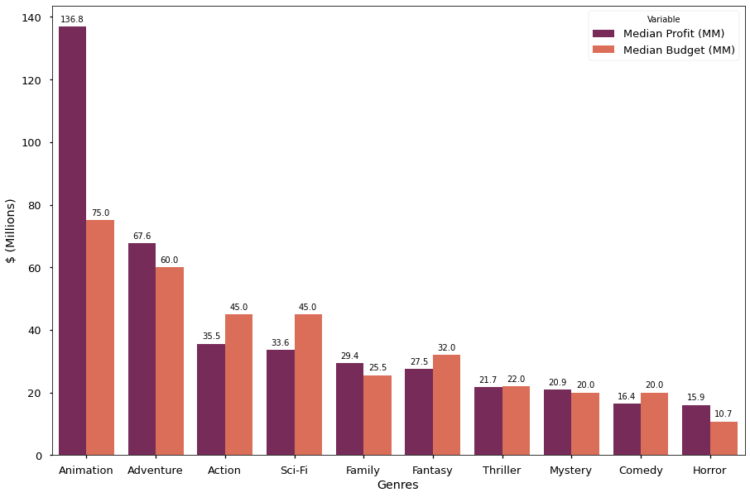
Films in the Animation genre are most profitable on average, while costing about half their NET earnings
Animation films outperformed all other genres with a median profit of 136.8MM. Median budget for this genre was 75MM.
Adventure and Family have high average profits as well while keeping low costs
Action, Sci-Fi, Fantasy, and Comedy genres have higher budgets than profit on average
Using the median rather than the mean excludes potential outliers in films, demonstrating Animation films as a clear winner

Slide 6
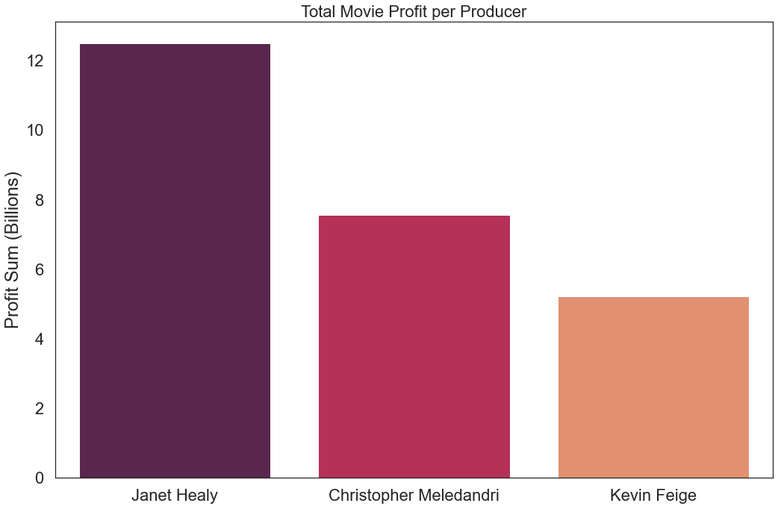
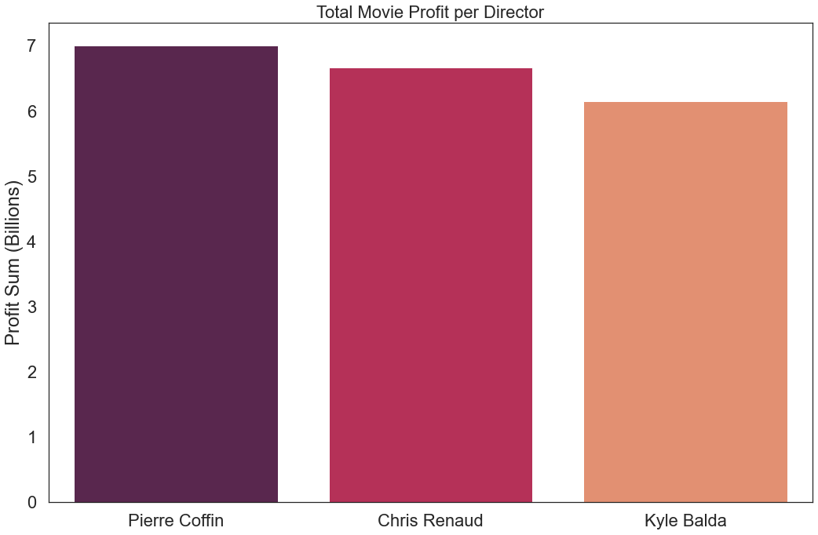
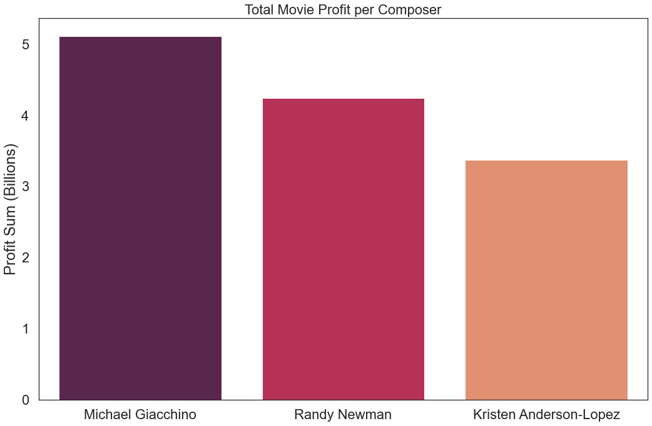
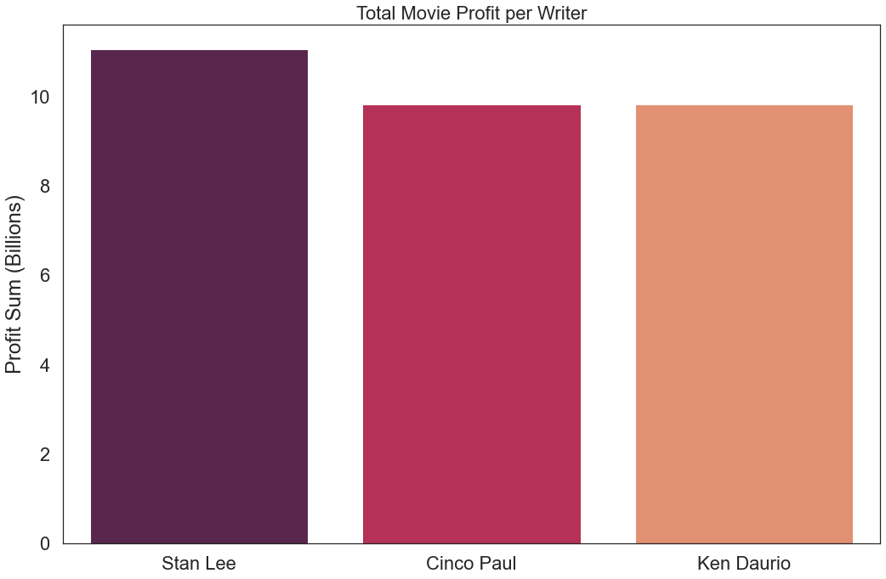
Hiring experienced crew members contributes to THE SUCCESS OF FILMS
Janet Healy is the most profitable producer with 7 works in the Animation Genre.
Pierre Coffin is the most successful Director in the Adventure, Animation, and Comedy Genres.
Michael Giacchino tops the list of most successful composers, with experience composing 6 works that vary in Genre
Cinco Paul and Ken Daurio write the most successful Animation, Adventure, and Comedy films

Slide 7
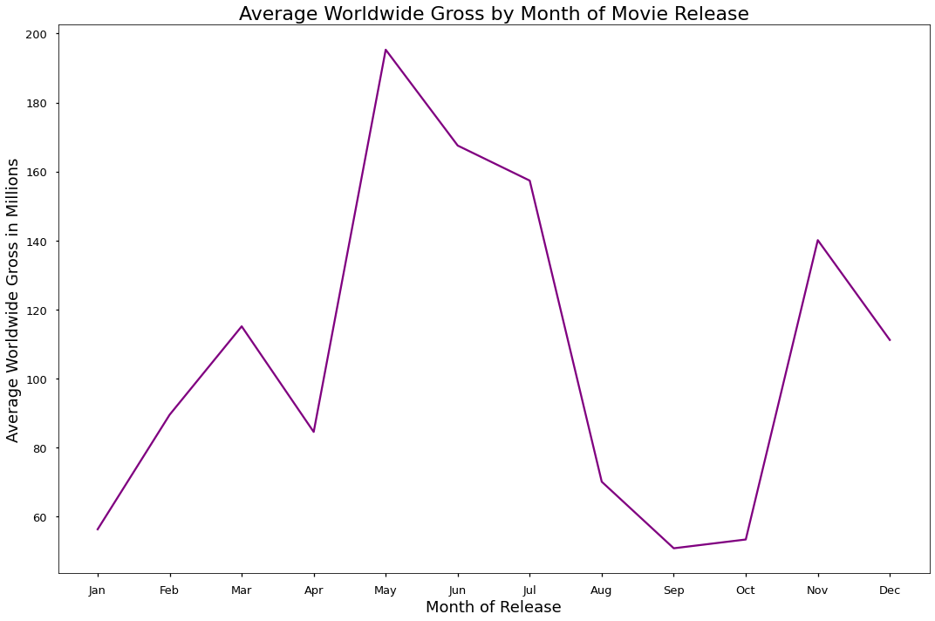
MAY FILM RELEASES GENERATE THE HIGHEST WORLDWIDE GROSS ON AVERAGE
Release Month | Gross (MM)
Jan | 56.3
Feb | 89.5
Mar | 115.1
Apr | 84.5
May | 195.3
Jun | 167.5
Jul | 157.3
Aug | 70.1
Sep | 50.7
Oct | 53.3
Nov | 140.1
Dec | 111.1
Movies released in late spring to early summer generate substantial worldwide gross, with May generating 195MM on average.
Late summer and early fall movie releases yield the lowest worldwide gross on average

Slide 8


Recommendations and next steps:
Kick off Microsoft’s movie studio with an Animation film, as this genre generates the highest profit with minimal risk of costing more than its gross earnings. Adventure and Family films also have high profits and low relative budgets on average.
Utilizing experienced crew members in the Animation genre such as Pierre Coffin as Director, Janey Healy as Producer, and Michael Giacchino as composer will yield successful films.
Microsoft should release films in May, June, or July, as viewers are more likely to hit the movie theatre in those months. Avoid delays as there is a sharp decline in viewership in Fall

